Slide 1
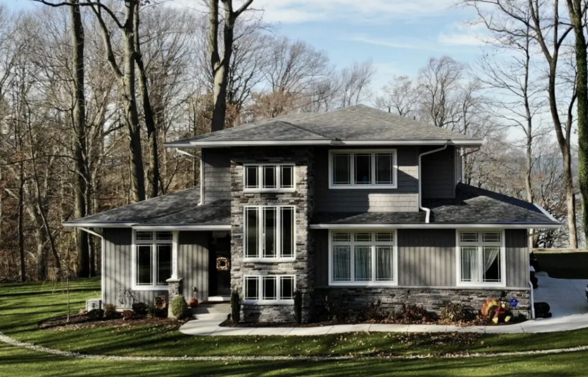
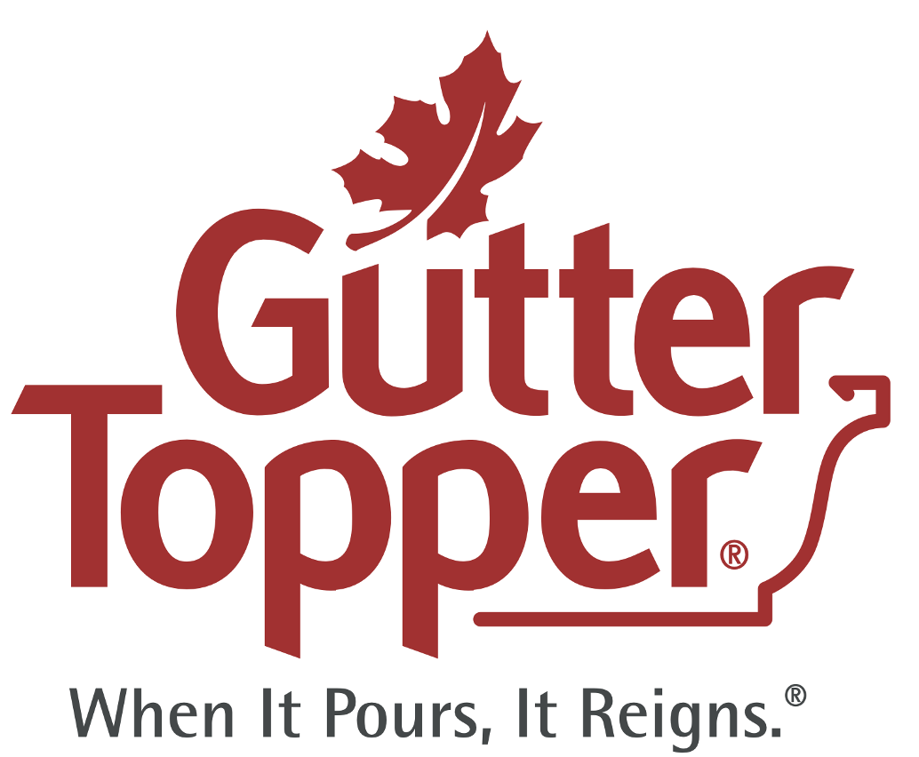

When it Pours, It Reigns
Your home is your most valued asset

Slide 2

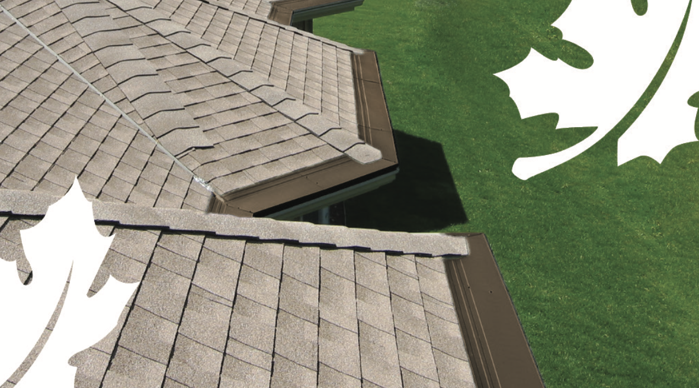

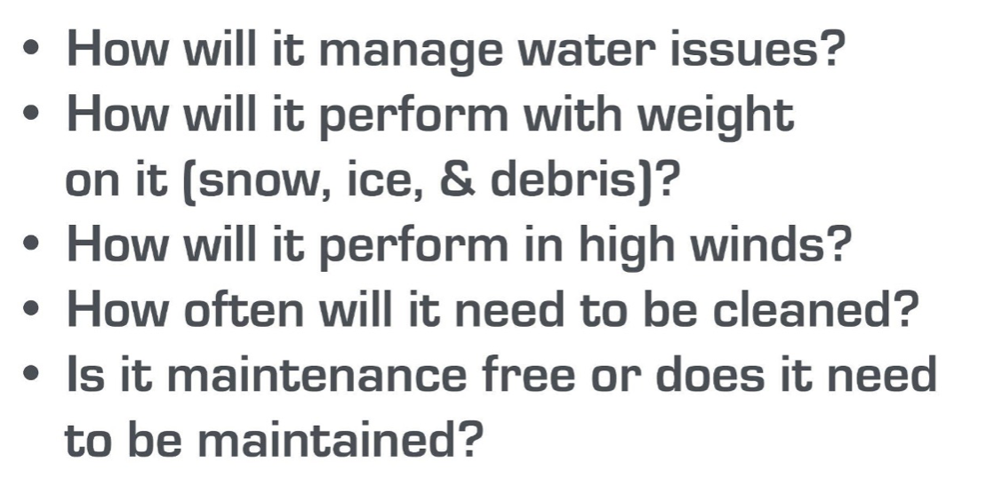
A Lifetime of Protection and Satisfaction

Slide 3
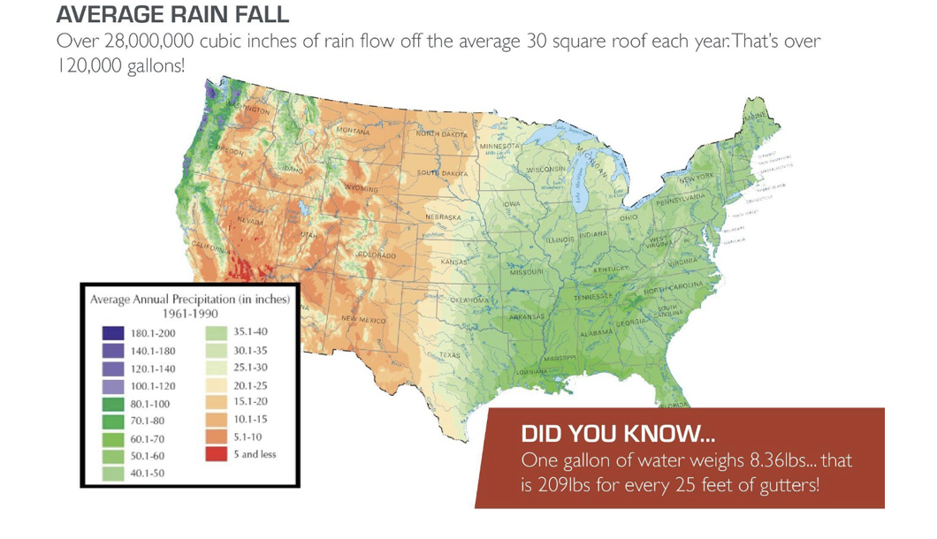
Water Management

Slide 4
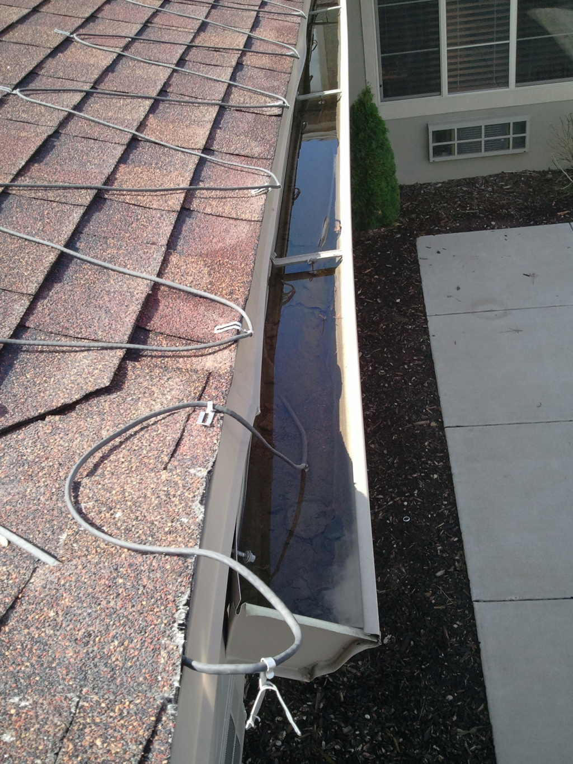
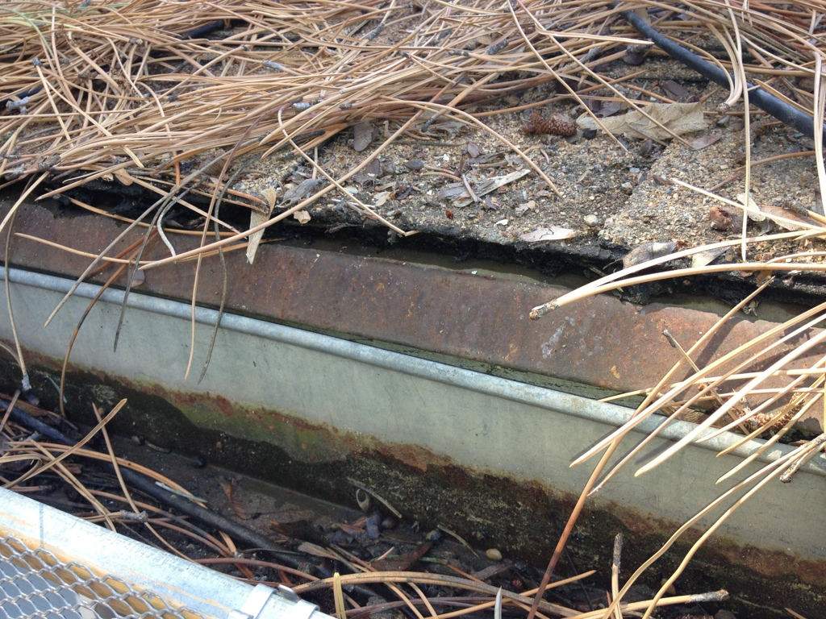

Potential Damage
Debris & subsequent blocked water,
create excess weight, causing gutters to pull away exposing fascia to water.

Slide 5
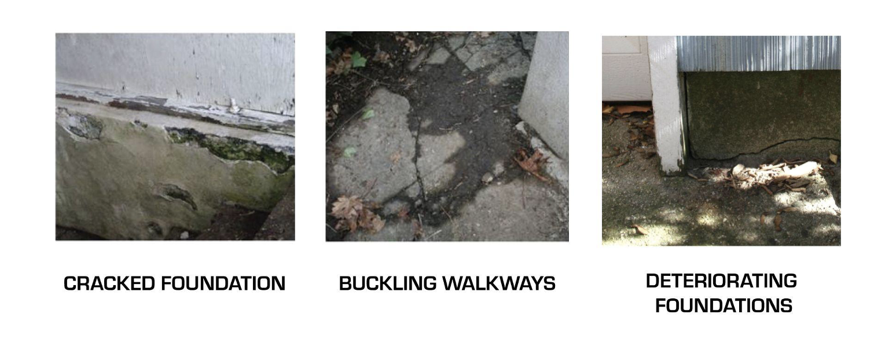

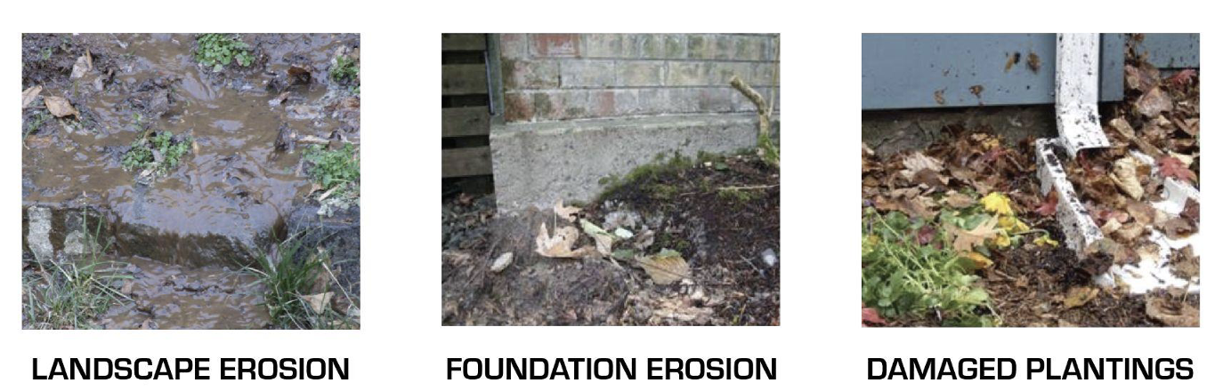
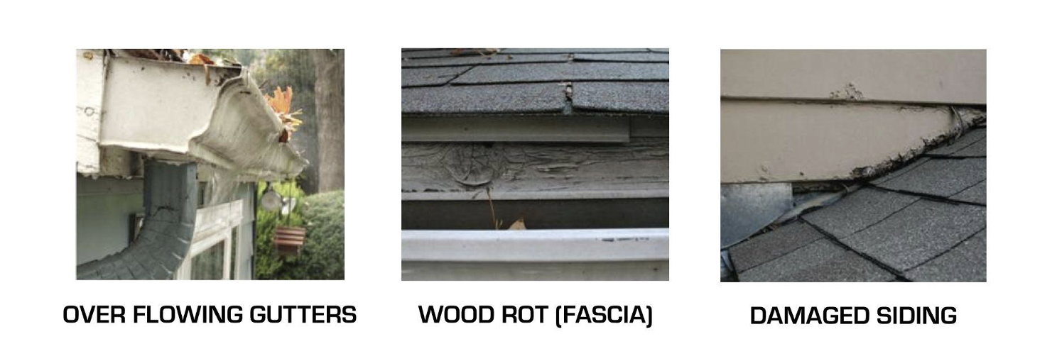
Potential Damage
Excessive damage occurs when gutters are clogged and not properly maintained. Water run off adversely affects everything from fascia, siding, walkways, landscaping and foundations

Slide 6
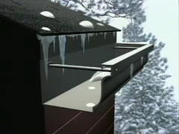
Winter Problems (VIDEO)
Ice and snow begin to fill up gutters quickly, causing potentially expensive structural damage
(VIDEO)
(VIDEO)

Slide 7
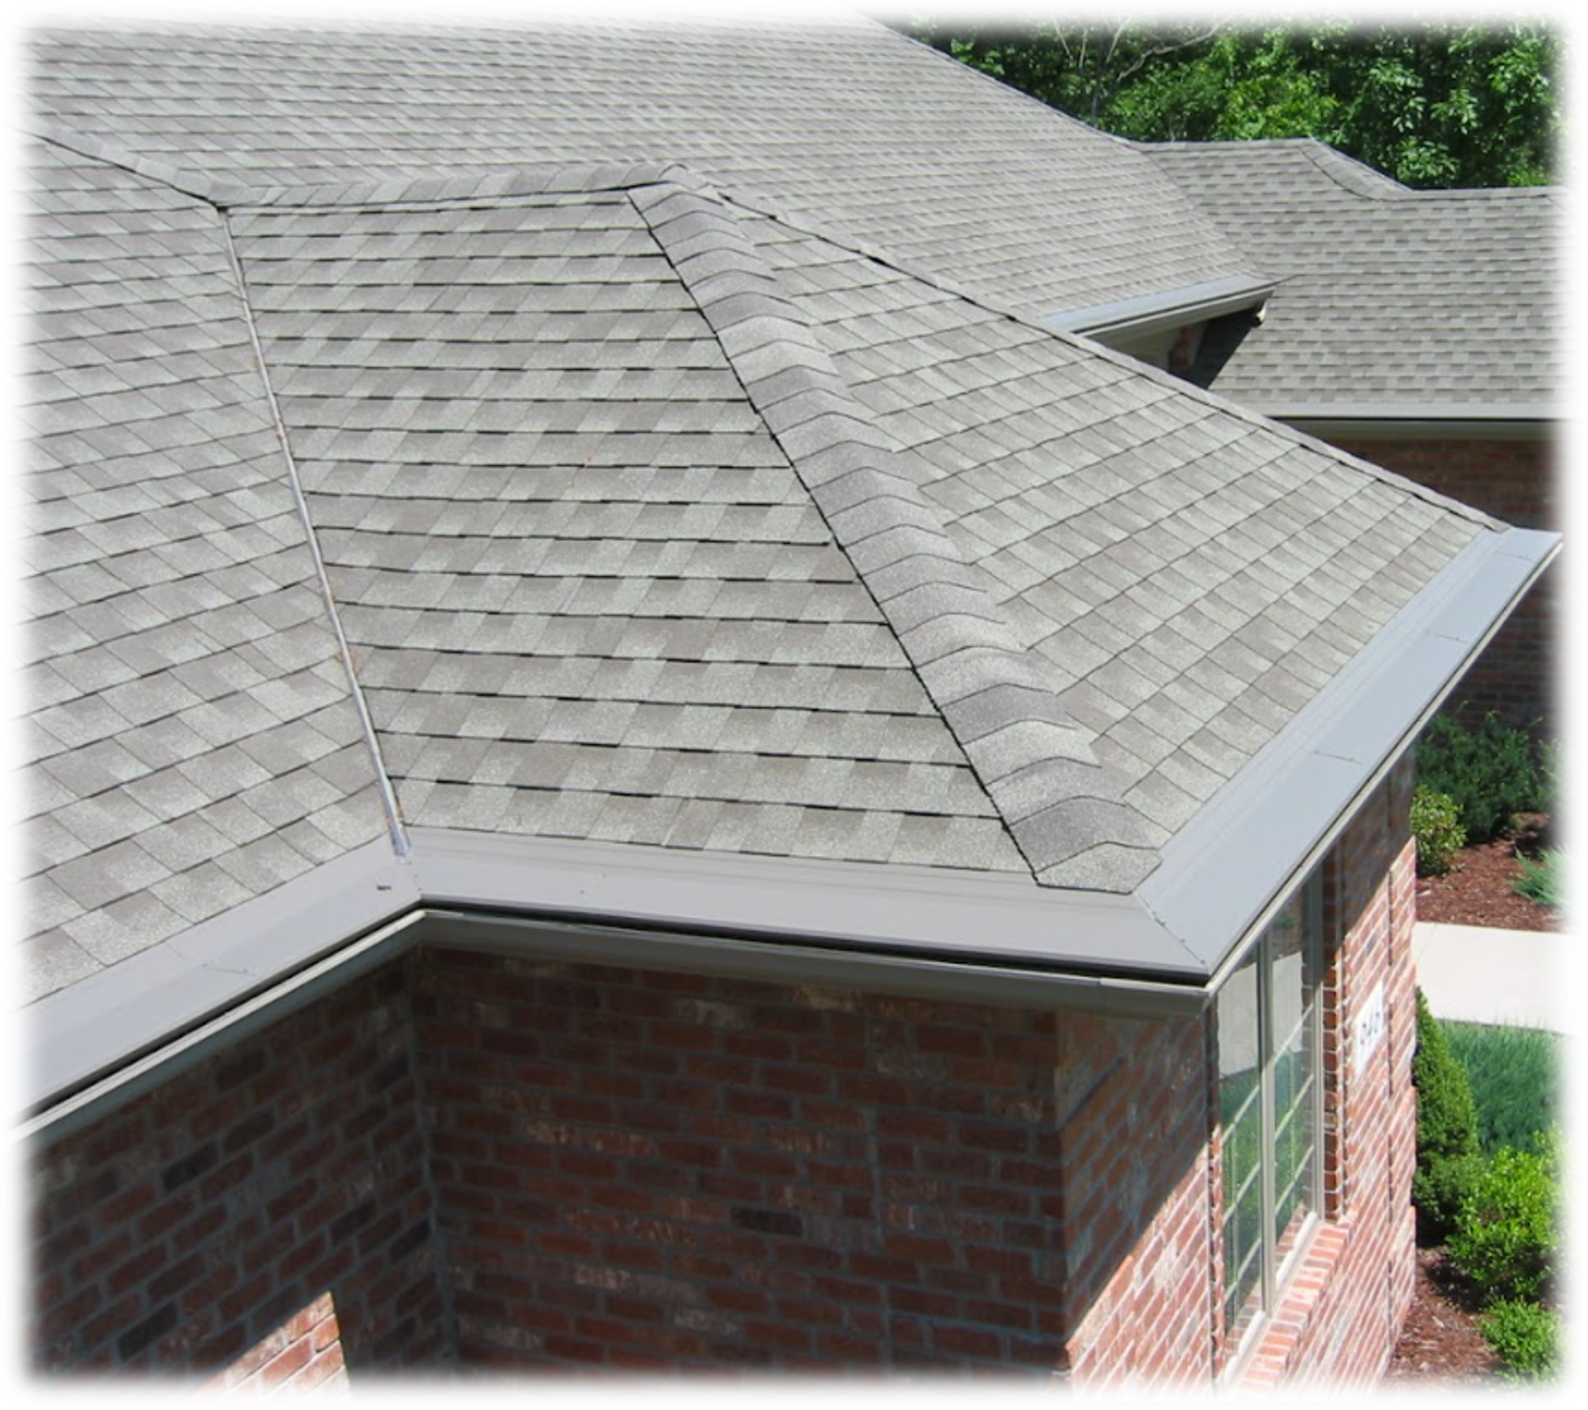
What Options Do you Have?
You can no nothing and hope that you have no roof or foundation damage
You can apply a temporary solution that may or may not work short term
You hire a professional service company to install a Gutter Topper lifetime solution
There is no better gutter system on the market. Gutter topper, with its patented engineering, is the most effective, efficient system available. Gutter Toppers design gives it a smooth silhouette that enhances your roof line. And it's available in a wide range of colors to blend with colors of your shingles and gutters. All products are proudly manufactured in the USA by Gutter Topper, a family owned company.

Slide 8
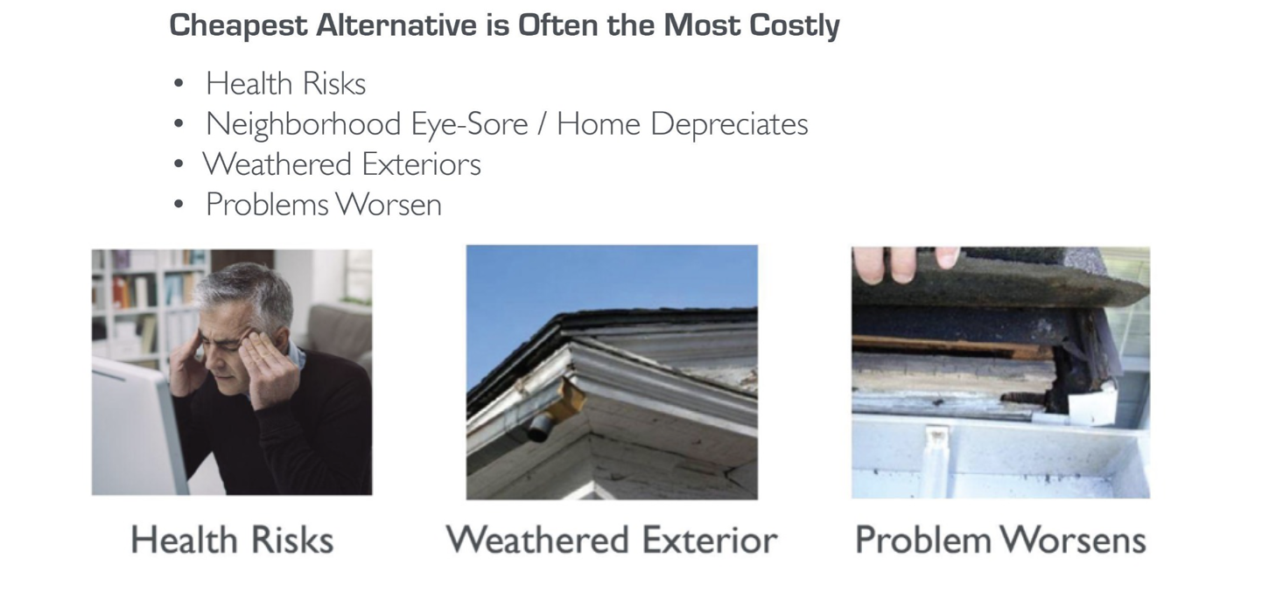
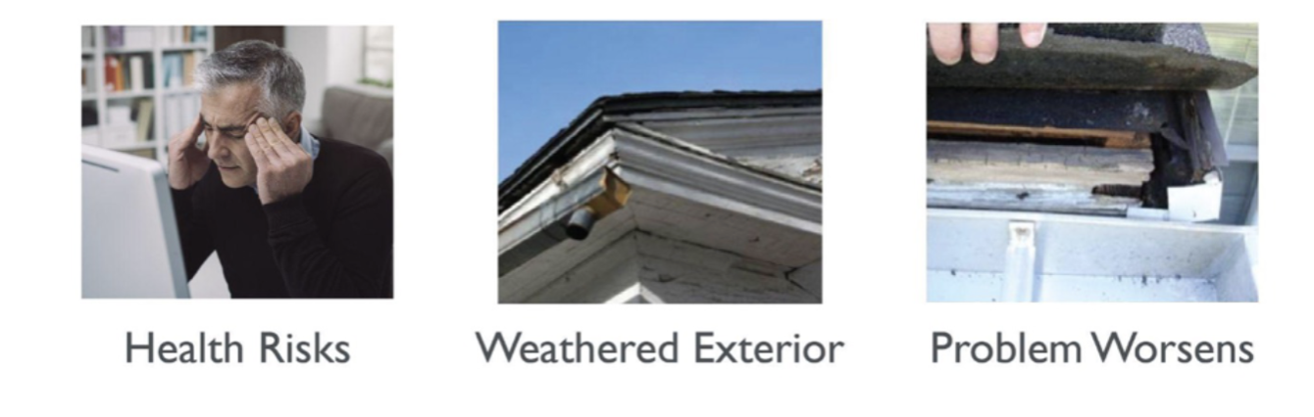
Option A) Do NOTHING

Slide 9
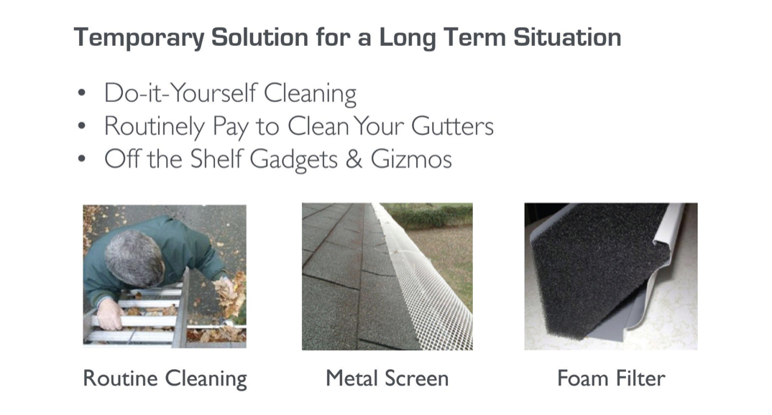
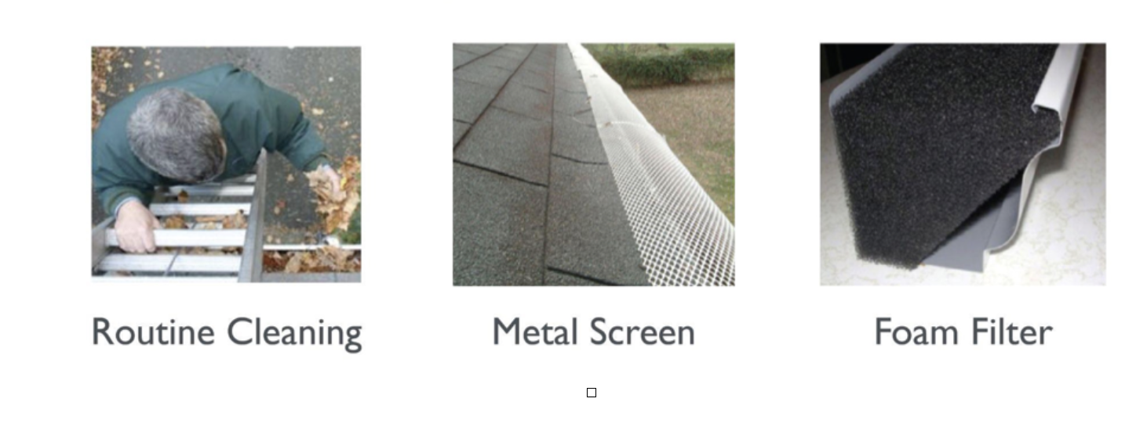
Option B) Temporary Fix

Slide 10
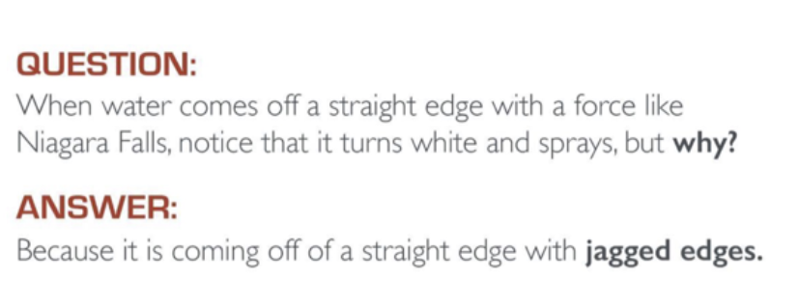
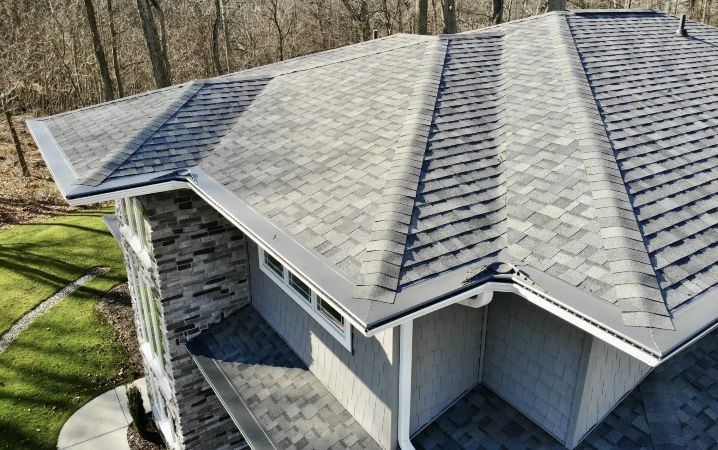
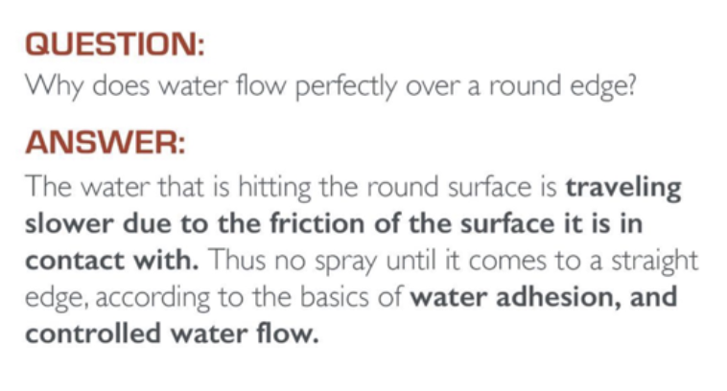
Option C) Install Gutter Topper and be Covered for Life

Slide 11
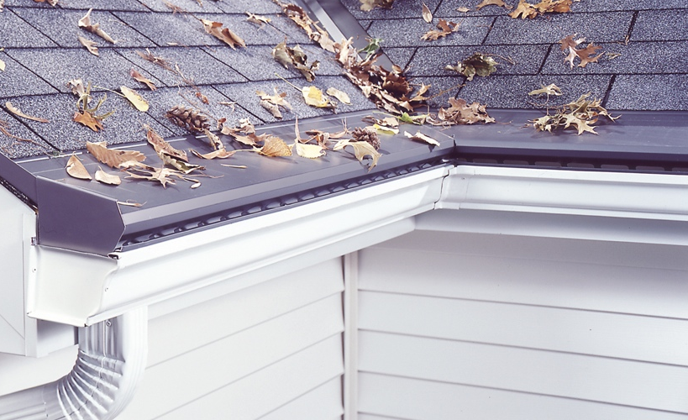




Installation will NOT void your manufacturers warranty!
Securely fastened to roof
under the 2nd course shingle,
and sealed with roof caulking
.024 “ Heavy duty aluminum
Reverse dip edge
Patented “Bird Guard”
Nose forward design

Slide 12
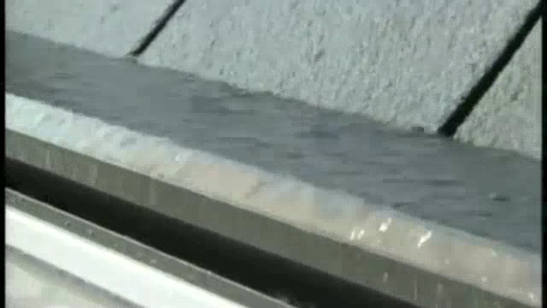
Water Management (VIDEO)
Where does the water go?
Mitigating up to 22 inches of rain per hour
(VIDEO)

Slide 13
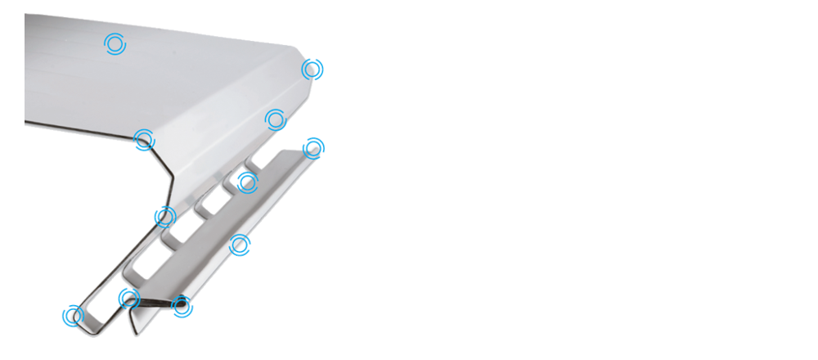


THE MOST SOPHISTICATED, HOODED STYLE LEAF PROTECTION MADE!
There is no better gutter system on the market. Gutter topper, with its patented engineering, is the most effective, efficient system available. Gutter Toppers design gives it a smooth silhouette that enhances your roof line. And it's available in a wide range of colors to blend with colors of your shingles and gutters. All products are proudly manufactured in the USA by Gutter Topper, a family owned company.
With its patented 11 critical bends of strength, gutter topper is design to withstand the worst that mother nature can throw at it!

Slide 14
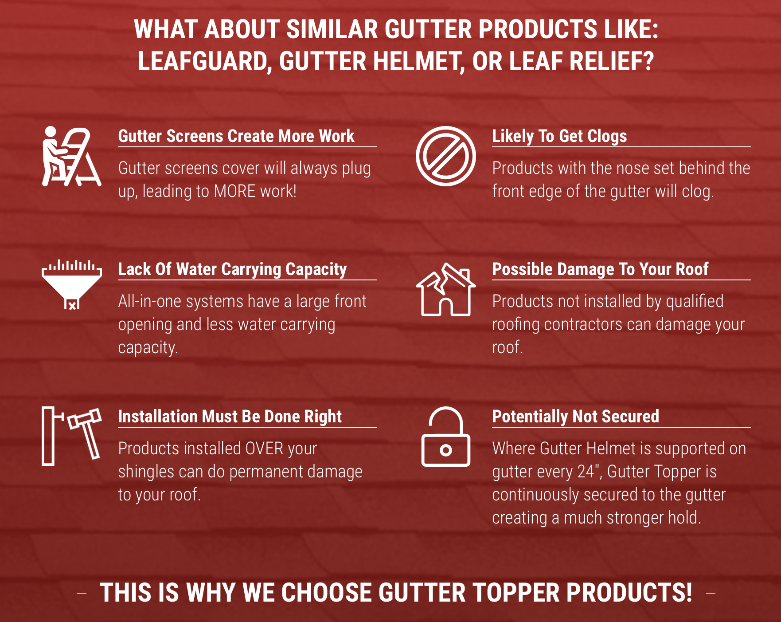

Benefits of Using a Gutter Topper Product

Slide 15
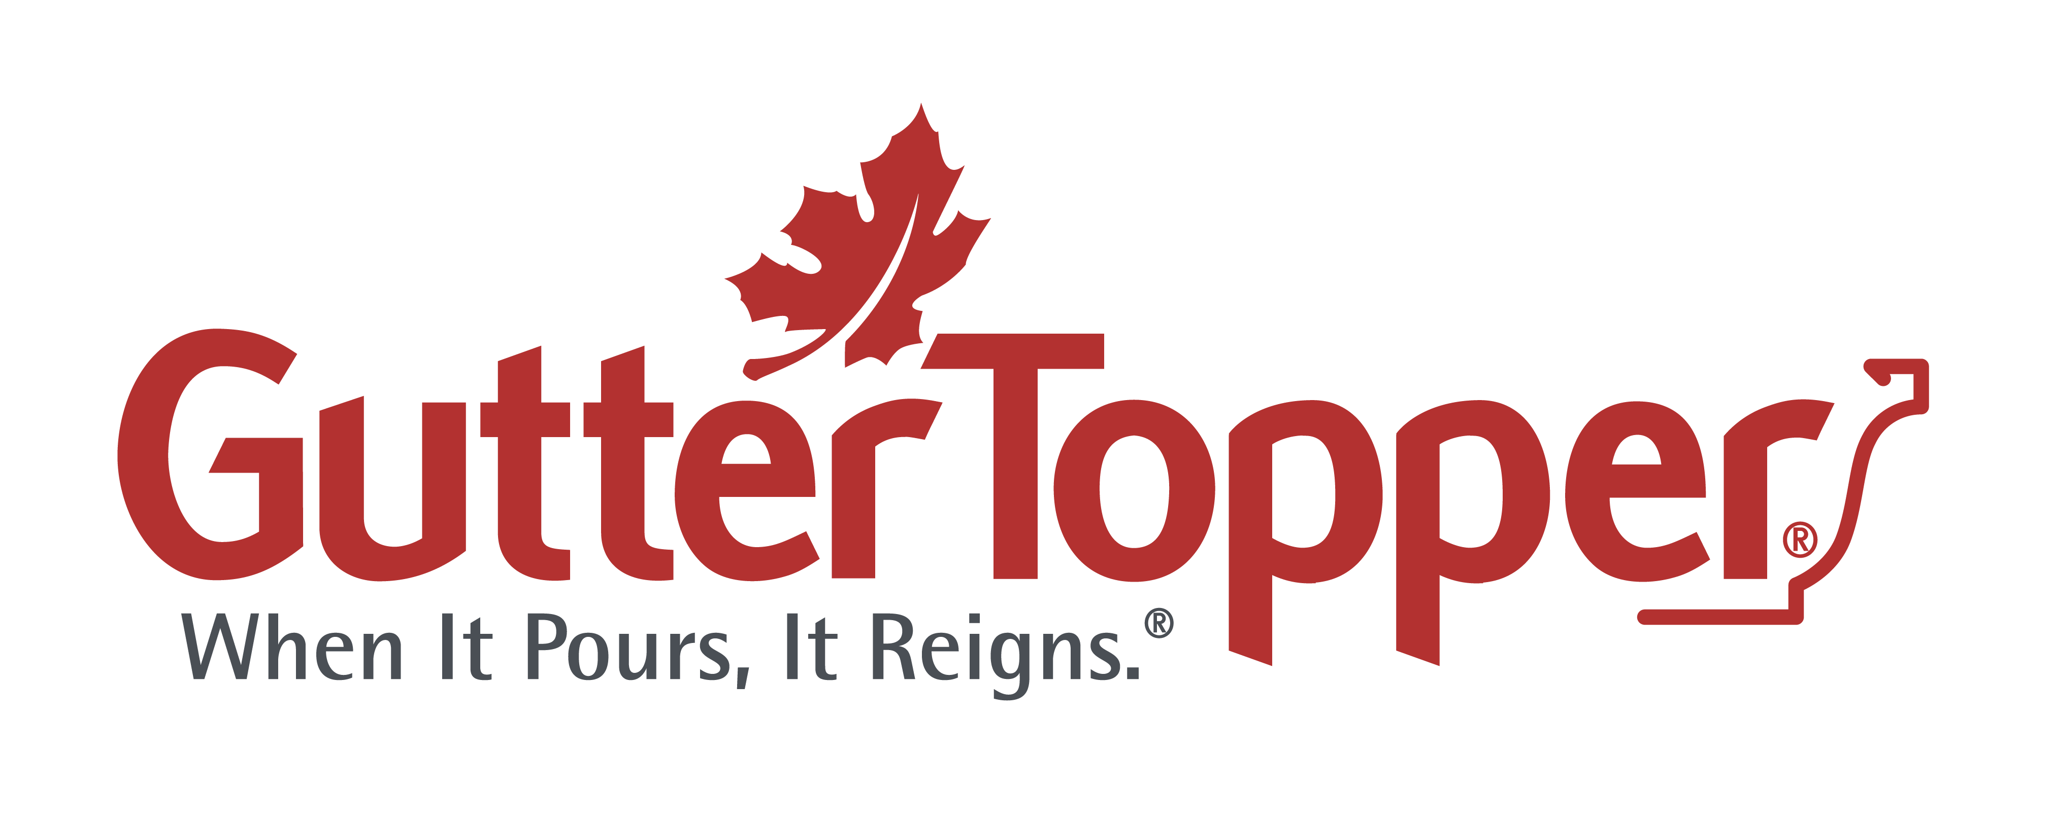





Products For Every Home
There is no better gutter system on the market. Gutter topper, with its patented engineering, is the most effective, efficient system available. Gutter Toppers design gives it a smooth silhouette that enhances your roof line. And it's available in a wide range of colors to blend with colors of your shingles and gutters. All products are proudly manufactured in the USA by Gutter Topper, a family owned company.

Slide 16

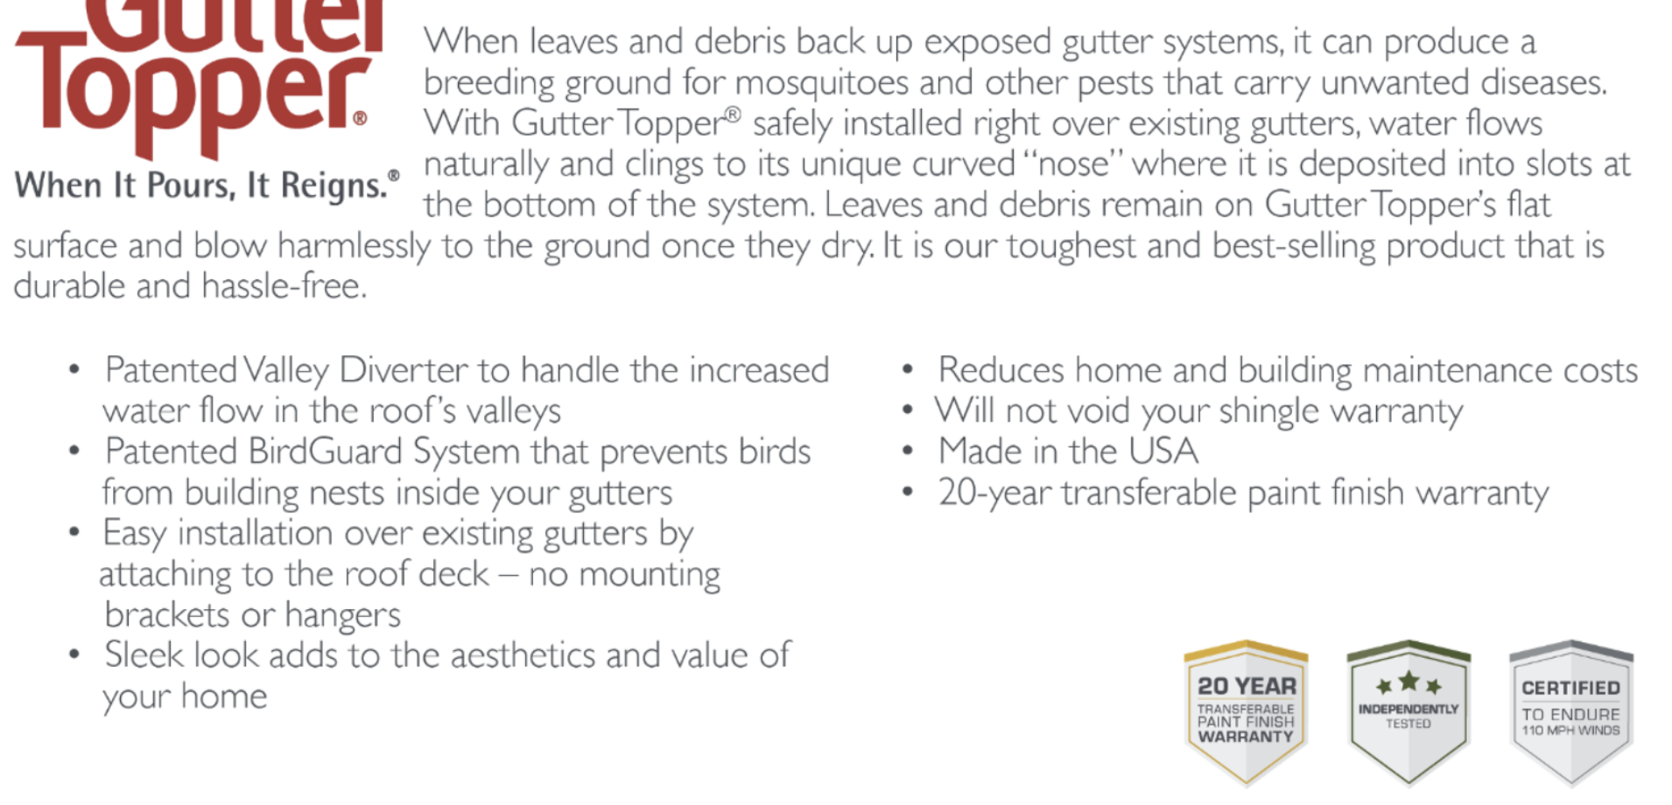

Slide 17

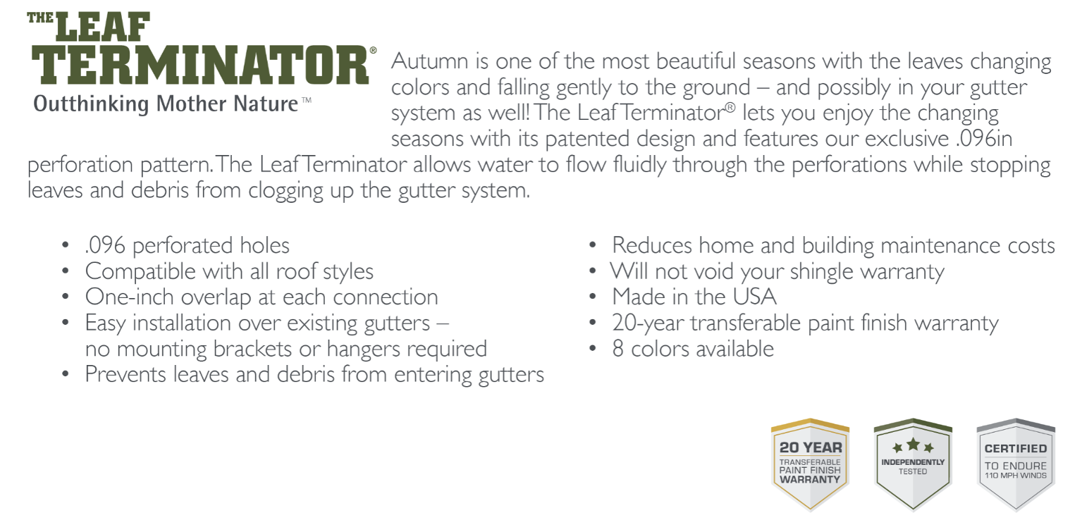



Slide 18
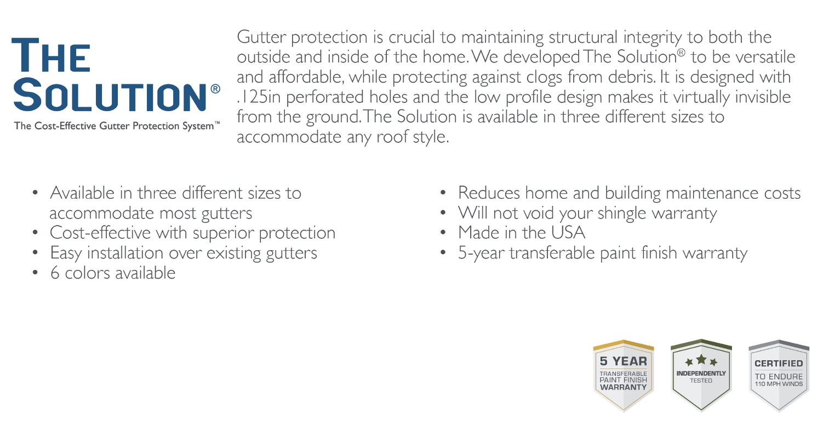


Slide 19
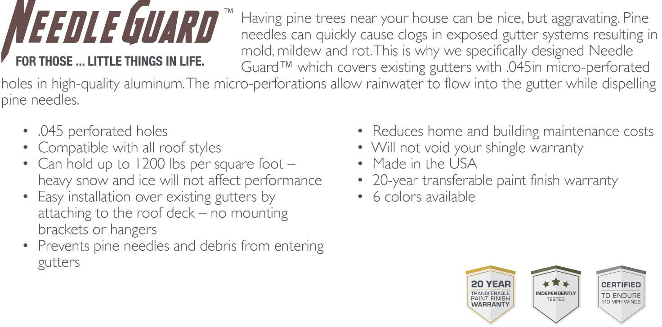

Slide 20
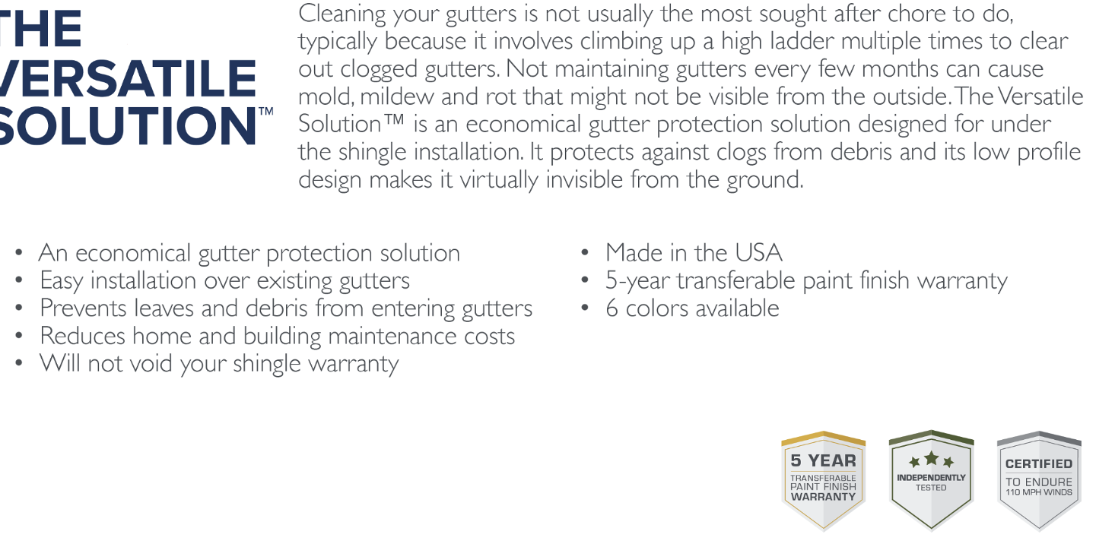


Slide 21
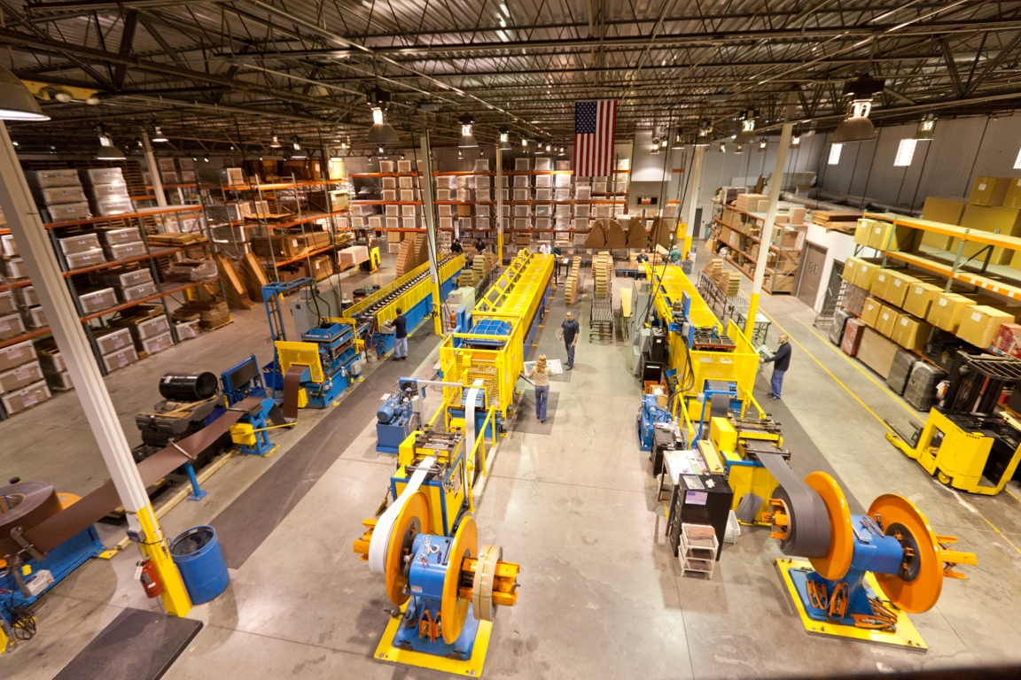
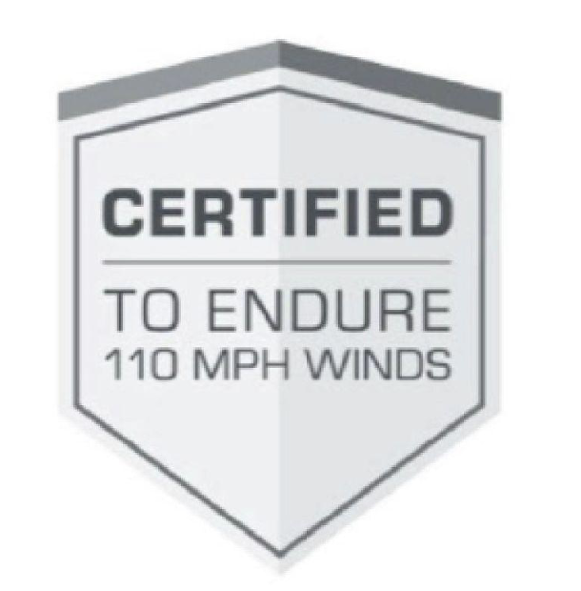
MADE IN THE USA
We manufacture all products in one facility, where we control and maintain the highest quality during the manufacturing process. We use bestie breed, world class roll formers to ensure unparalleled performance and assure our toppers contain zero blemishes. And all of our Toppers are certified to withstand 110 mph winds with no lift or movement

